Slide 1


Slide 2
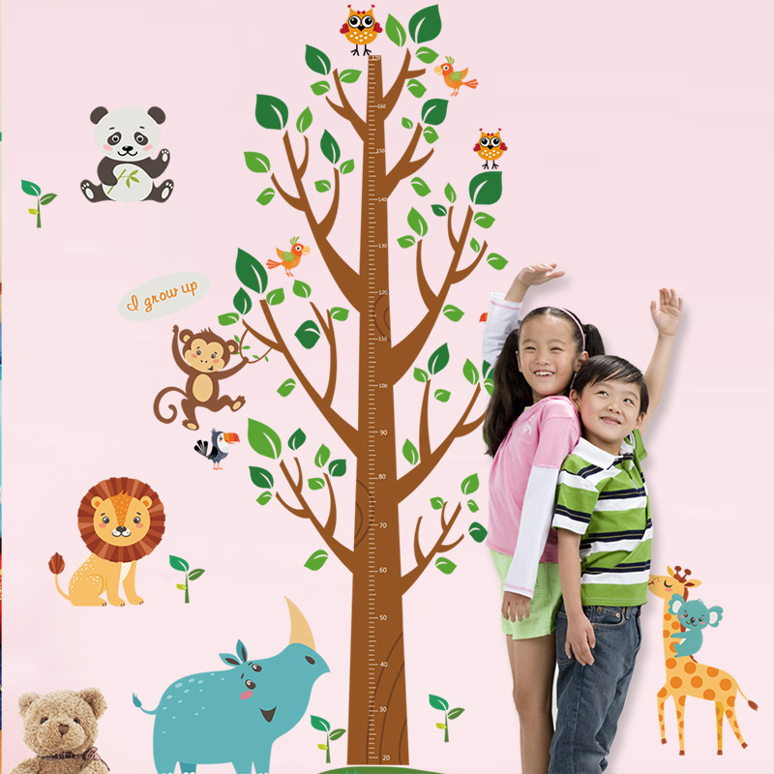
Objectives
Identify Typical Developmental Stages Including:
    Gross and Fine Motor Development
    Languages Skills
    Cognitive Development
    Social – Emotional
For youth ages 4 to 12 years old

Slide 3
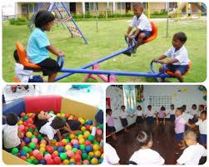
Developmental Milestones: 4 to 5 Year Olds
Movement (Gross Motor)
Stands on one foot for ten seconds or longer
Hops and somersaults
Swings and climbs
May be able to skip

Slide 4
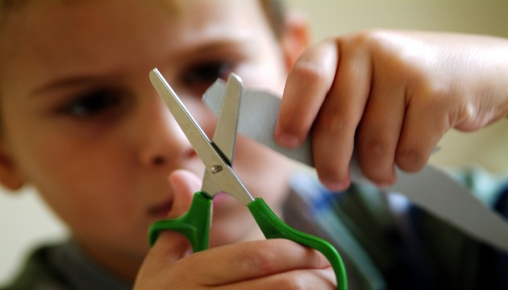
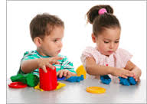
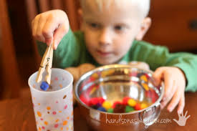
Developmental Milestones: 4 to 5 Year Olds
Hand and Finger Skills Fine Motor
Copies triangle and other geometric patterns
Draws person with body
Prints some letters
Dresses and undresses without assistance
Usually cares for own toilet needs

Slide 5
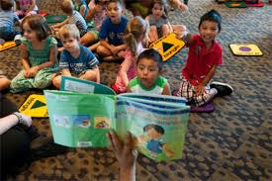


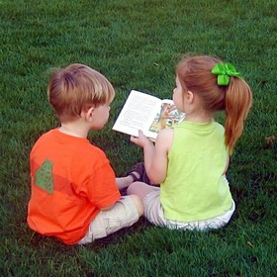
Developmental Mile stones 4 to 6 year olds
Language
Recalls part of a story
Speaks sentences of more than five words
Uses future tense
Tells longer stories
Says name and address

Slide 6
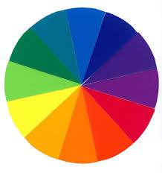
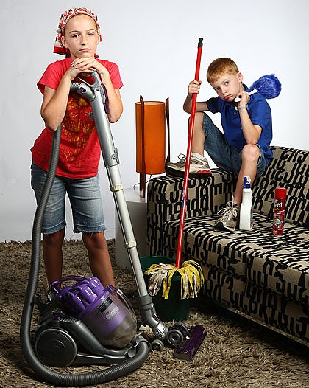

Developmental Milestones: 4 to 5 Year Olds
Cognitive
Can count ten or more objects
Correctly names at least four colors
Better understands the concept of time
Knows about things used every day in the home

Slide 7
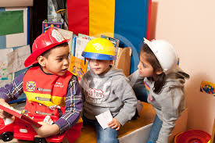
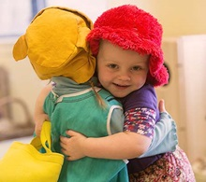
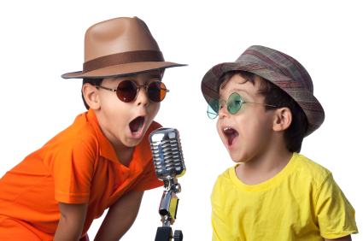
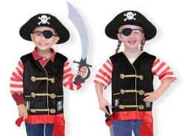
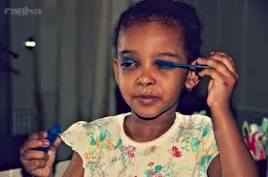

Developmental Milestones: 4 to 5 Year Olds
Social Emotional
Wants to please friends
Wants to be like her friends
More likely to agree to rules
Shows more independence
Aware of sexuality
Able to distinguish fantasy from reality

Slide 8
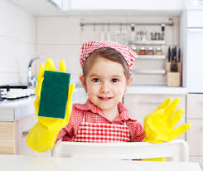

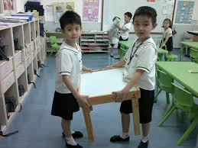
Positive Tips
Continue to read to your child and include it in on your daily schedule
Have your child help with simple chores
Encourage your child to play with other children and talk about the value of good friends.

Slide 9
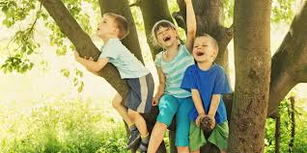
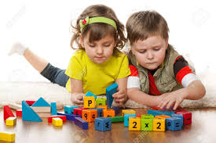
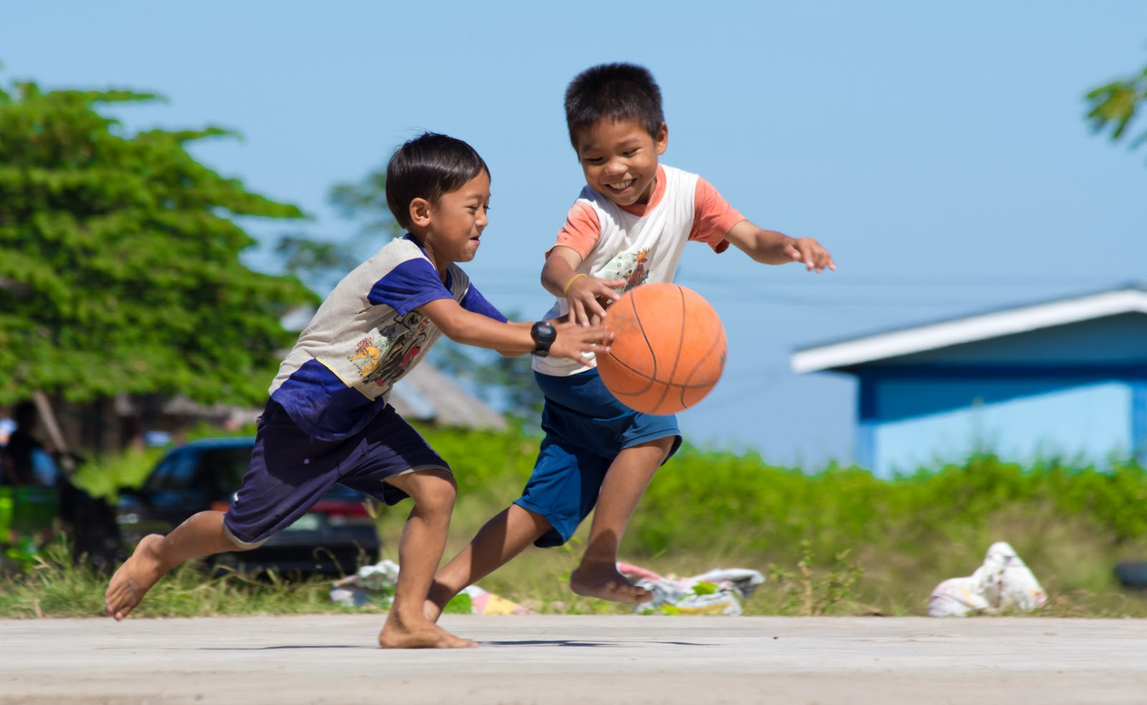
Developmental Milestones: 6 to 7 Years
Motor Skills
Use one hand consistently for fine motor tasks
Interested in games with rules and but lacks skill
Use a fork and knife together to cut soft foods
Get dressed by themselves including fasteners
Enjoys roughhousing, but does not know when to stop; may end up hurt, upset, or exhausted

Slide 10

Developmental Milestones: 6 to 7 Years
Language
Learning to write letters and numbers/ often backwards
Listens as well as talks at mealtime
Begins to enjoy reading as a pastime if he or she has had success in this skill
Complains of unfair treatment by playmates

Slide 11
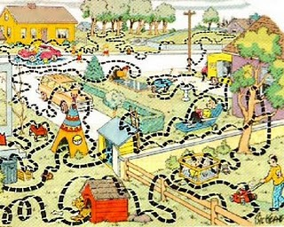
Developmental Milestones: 6 to 7 Years
Cognitive Development
Has a difficult time making choices and decisions
Sees teacher as authority
Sees the end result as more important than the "route"
Likes to know rules

Slide 12
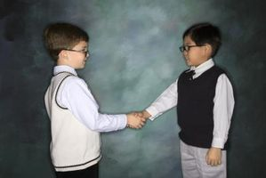
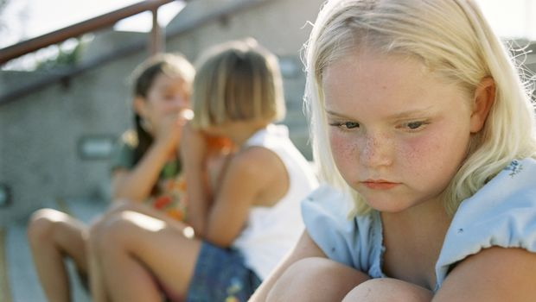
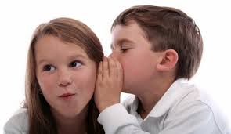

Developmental Milestones: 6 to 7 Years
Social Emotional
More ready to dish out criticism than to receive it
Sensitive to reactions of others
Begins to show politeness and consideration
Begins to be modest and concerned about "private parts" or sexual organs
Shows friendship by possessions, secrets, and time together

Slide 13
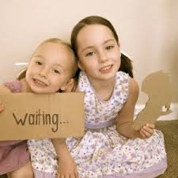

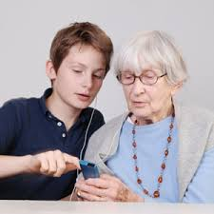
Positive Tips
Help your child develop a sense of responsibility - ask them to help with household tasks
Talk about respecting others and helping people in need
Help your child learn patience by letting others go first or finishing a task before going out to play

Slide 14

Developmental Milestones: 8 to 12 Years
Motor skills
Does well at games/sports requiring skill, strength and agility
Large and fine motor skills becoming highly coordinated
Preparation for puberty

Slide 15
Developmental Milestones: 8 to 12 Years
Language
Gives accurate directions to others
Uses more abstract and specific vocabulary and grammar, complex sentences in writing than in conversation
Can explain relationships between meanings of multiple-meaning words
Understands jokes and riddles based on sound similarities
"Last night I shot an elephant in my pajamas. How he got in my pajamas, I'll never know." - Groucho Marx
"What kind of shows to cows like to watch?"
"Moo-sicals”
"You're a couch potato."
“Its raining cats and dogs out there.”

Slide 16
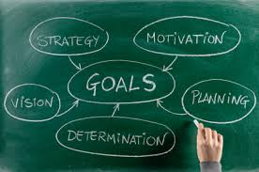
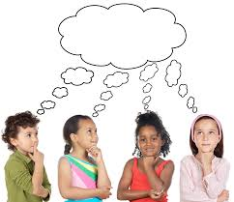
Developmental Milestones: 8 to 12 Years
Cognitive
They begin to think hypothetically, considering a number of possibilities, and are able to think logically.
They become more goal oriented.
They may enjoy reading a book. They can interpret the context of a paragraph and writes stories.
They may develop special interests that are a source of motivation.

Slide 17

Developmental Milestones: 8 to 12 Years
Social/ Emotional
Most early adolescents are fully capable of perspective taking and understand and consider other's perspectives.
They begin to understand facets of the adult world like money and telling time.
may resent being told what to do, yet needs constant reminders regarding routine responsibilities
shows a change of interest in the opposite sex

Slide 18



Positive Tips
Use phases like “You must be proud of yourself” rather than ”I’m proud of you” and encourage positive choices when no one is there to praise their efforts.
Help your child develop a personal sense of right and wrong. Talk specifically about peer pressure and plans to deal with it.
Help your child set individual goals and to think about how to develop skills to accomplish them

Slide 19

Questions
CONTACT INFORMATION:
Sue Ownby
Parent Liaison
Knox County Schools
Sue.ownby@knoxschools.org
865-594-8889

Slide 20
References
American Academy of Pediatrics - Healthychildren.org Caring for Your Baby and Young Child: Birth to Age 5 (Copyright © 2009 American Academy of Pediatrics)
References & Resources: Benson, P. L. (2006). All kids are our kids: What communities must do to raise caring and responsible children and adolescents (2nd ed.). San Francisco: Jossey-Bass.Center for Disease Control and Prevention (2014, June 23). Middle childhood (6-8 years ofage).Retrievedfrom http://www.cdc.gov/ncbddd/childdevelopment/positiveparenting/middle.htmlCenter for Disease Control and Prevention (2014, June 23). Middle childhood (9-11 years of age). Retrieved from http://www.cdc.gov/ncbddd/childdevelopment/positiveparenting/middle2.htmlCenter for Disease Control and Prevention (2014, June 23). Young teens (12 -14 years of age).Retrieved fromhttp://www.cdc.gov/ncbddd/childdevelopment/positiveparenting/adolescence.htmlInstitute for Human Services for the Ohio Child Welfare Training Program (2007). Developmental milestones chart. Retrieved fromhttp://www.rsd.k12.pa.us/Downloads/Development_Chart_for_Booklet.pdfLeffert, N., Benson, P., & Roehlkepartain, J. (1997). Starting out right: Developmental assets for children. Minneapolis, MN: The Search Institute.
Adapted by Anne L. Heinsohn, former associate professor of extension education, from Children-How They Grow: Elementary School Children Ages 6 to 8 and 9 to 12, Bulletins GH 6230 and GH 6231, by Mary McPhail Gray and Terry Foltz, University of Missouri, Columbia

